Slide 1

Note: The data and information in this document is reflective of a hypothetical situation and client. This document is to be used for KPMG Virtual Internship purposes only.
Sprocket Central Pty Ltd
Data analytics approach
Faith Temitope Ajiboye-Femi

Slide 2
Note: The data and information in this document is reflective of a hypothetical situation and client. This document is to be used for KPMG Virtual Internship purposes only.
Agenda
Introduction
Data Exploration
Model Development
Interpretation

Slide 3
Note: The data and information in this document is reflective of a hypothetical situation and client. This document is to be used for KPMG Virtual Internship purposes only.
Introduction
Recommendations for the 1000 new customers to be targeted.
Sprocket Central Pty Ltd is a long-standing KPMG client whom specializes in high quality bikes and accessible cycling accessories to riders. Their marketing team is looking to boost business by analyzing their existing customer dataset to determine customer trends and behavior.
The three datasets provided would be analyzed and used to identify the behavior patterns of existing customers so as to be able to recommend the new customers that should be targeted.
The approach that would be taken for this analysis are in three phases, namely; Data Exploration, Model Development, and Interpretation.
The activities carried out would include;
Understanding the data distributions
Feature engineering
Data transformations

Slide 4
Note: The data and information in this document is reflective of a hypothetical situation and client. This document is to be used for KPMG Virtual Internship purposes only.
Introduction
Modelling
Results interpretation
Reporting
Understanding the data distributions
Age distributions of the existing and new customers
Number of bikes purchased in 3 years
Job industry category
Wealth segments
Number of cars owned in each states

Slide 5
Note: The data and information in this document is reflective of a hypothetical situation and client. This document is to be used for KPMG Virtual Internship purposes only.
Data Exploration
Data Quality Assessment Test
Key issues for Data Quality Assessment
Accuracy : Correct Values
Completeness: Data Fields with values
Consistency: Values free from Contradiction
Currency: Values up to date
Relevancy: Data Items with Value Meta-data
Validity: Data Containing Allowable Values
Uniqueness: Records that are Duplicated
A copy of the data quality assessment has been sent to the client.

Slide 6
Note: The data and information in this document is reflective of a hypothetical situation and client. This document is to be used for KPMG Virtual Internship purposes only.
Data Exploration
‘New’ and ‘Old’ Customer Age Distributions
The age ditribution in these charts can be summarised as follows; Age Distribution(20=-below 20,30= 20 to 29, 40= 30-39)
Majority of the old customers are aged between 40-49.The age groups 20 and 80 has the least customers
In the new customers segment, most of the customers are ged between 40-49 with ag group 20 having the least number of customers.

Slide 7
Note: The data and information in this document is reflective of a hypothetical situation and client. This document is to be used for KPMG Virtual Internship purposes only.
Data Exploration
Bike related purchases over the last 3 years by gender
Over the last three years about 50% of bike related purchases were made by females to 48% of purchase made by males. Approximately 2% were made by unknown gender
Females make up majority of bike related sales

Slide 8
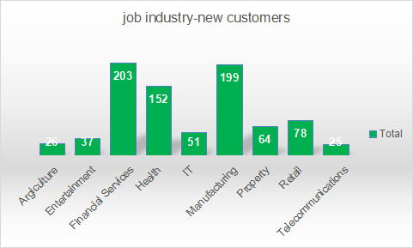
Note: The data and information in this document is reflective of a hypothetical situation and client. This document is to be used for KPMG Virtual Internship purposes only.
Data Exploration
Job Industry Distribution
Majority of customers in the old and new segment belongs to the manufacturing industry category.
In both segments, telecommunications and agriculture has the least number of customers.

Slide 9
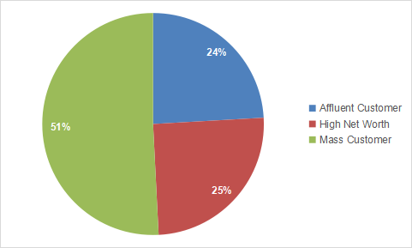
Note: The data and information in this document is reflective of a hypothetical situation and client. This document is to be used for KPMG Virtual Internship purposes only.
Data Exploration
Wealth Segmentation by Age category
In the new customer segment, most of th customrs are affluent customers.
▪ In all wealth segments(old), the largest number of customers are aged between 40-49

Slide 10
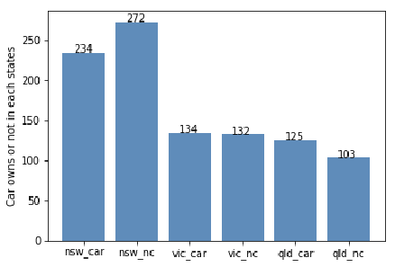
Note: The data and information in this document is reflective of a hypothetical situation and client. This document is to be used for KPMG Virtual Internship purposes only.
Data Exploration
Number of cars owned and not owned by state
NSW should be considered the most since numbers of customers don’t own cars is significantly larger than that own.
VIC and QLD has more customers that own car that who don’t but we can try to have something so that those owns car will buy bikes.

Slide 11
Note: The data and information in this document is reflective of a hypothetical situation and client. This document is to be used for KPMG Virtual Internship purposes only.
Model Development
RFM model Analysis and Customer Classification
• RFM analysis is used to determine which customers a business
should target to increase its revenue and value.
• It uses sales data to segment a pool of customers based on
their purchasing behavior. • The resulting customer segments are neatly ordered from most
valuable to least valuable. This makes it straightforward to
identify best customers.
• The RFM(Recency, Frequency and Monetary) model shows
customers that have displayed high levels of engagement with
the business in the three categories mentioned.

Slide 12
Note: The data and information in this document is reflective of a hypothetical situation and client. This document is to be used for KPMG Virtual Internship purposes only.
Appendix

